Slide 1

The Non-Emergency Medical Transportation(NEMT)
Software Development Plan
Rutta Kidane
School of Technology, National University
6018692259: Innovation & Strategy in Computer Science
Dr. David Bouvin
August 20, 2023
This Photo by Unknown author is licensed under CC BY-NC-ND.
Notes:
The Non-Emergency Medical Transportation(NEMT)
Software Development Plan

Slide 2
Contents
1. Business Need Assessment and Requirements Analysis with SWOT
2. Project Work Plan
3. Measuring and Reporting Team performance and Project progress
4. Risk Reduction Strategy and Legal Consideration
5. IT Support program in the Healthcare Technology Company
Notes:
Contents

Slide 3

Introduction
The Non-Emergency Medical Transportation(NEMT) User Interface Software is proposed by a software development team based in Denver; Colorado.
The NEMT was only available to the transport agencies.
The NEMT user interface is proposed as refinement project to the Non-Emergency Medical Transportation Driver Interface Software.
The user interface of NEMT have similar functionality and features to Uber user interface.
The team coordinates business need assessment , requirement analysis , resource allocation techniques, IT solution design, IT support services and business continuity plan and ethical consideration to create the NEMT(Modicare, 2023).
Notes:
The Healthcare technology company software development team based in Denver; Colorado proposed a new project to create a Non-Emergency Medical Transportation(NEMT) User Interface Software.
Non-Emergency Medical Transportation(NEMT) was only used by the driver transport agencies and the client could not easily book trips and had difficulties to reach medical care destinations.
The healthcare company as its continuous effort in making a health care accessible to communities specially to underserved communities has developed a new additional system product to existing products of remote patient care, and personal care IT solutions and a refinement project to the Non-Emergency Medical Transportation Driver Interface Software (Modicare, 2023).
The user interface of NEMT have similar functionality and features to Uber user interface. As Addivice (2023) describes Uber user interface functionality and features, the NEMT user interface app has features such as register, login , booking , select car type, insert location , insert destiny, ride tracking, messaging, calling, book for later, cancel the trip, rate the trip and more. Using the app clients can be able to sign up to open a ride account, sign in to access the app, book for a ride, select type of car, insert pick up and destiny location, track the ride, call, or message to customer services, cancel the ride, book a ride for later and rate the trip experiences.
The NEMT project team believes a carefully designed software development work plan and well coordination of human and technical resources achieves a sound system solution. Thus , the team coordinates standardized techniques, methodologies, and tools to plan, design, develop, implement, deploy , and maintain the proposed system solutions. These includes business need assessment , requirement analysis , resource allocation techniques, IT solution design, IT support services and business continuity plan and ethical consideration.

Slide 4

1. Business Need Assessment and Requirements Analysis with SWOT
A valuable tool for clients by giving efficiency, easiness and time effectiveness
24/7 transport service.
Multiple level of support in time of emergency or disaster.
A supplement a reliable and safe medical and social trip.
User interface will be in the form of mobile application, web portals , and interactive voice response(IVR)
Programming languages of JAVA, PHP, HTML, and Swift, and SQL ;Mobile app development frameworks such as Native app and web native mobile ;and Artificial Intelligence(AI) and 5G Technology will be utilized (Fingent, n.d.).
Notes:
Business Need Assessment and Requirements Analysis with SWOT
The newly proposed system solution will be valuable tool for clients by giving efficiency, easiness and time effectiveness
Before, clients should call to the transport company to request for medical transportations and sometimes wait for long to get responses.
The transport service was not flexible to provide services whenever clients want, and wherever they are located , since clients could not access the service system at any point of time they wanted. It was hard to track the requested ride , cancel the ride, schedule the ride for later, or rate their own trip experiences because they should call or contact the transport company and wait for the responses all over again as well.
As Modivcare(2023) stated the NEMT will add a substantial merit in extending client experiences to the best.
Client will access the medical transport service 24/7 by just downloading the app and able to reach their destination to any medical appointment place whenever they want to. Using the app , not only client get transport service, but also have a contact to live care services with multiple level of support in time of emergency or disaster. With innovative technology in using Geo-location and SMS notification system , the newly developing system solution also be a user-friendly platform to supplement a reliable and safe medical and social trip.
The NEMT user interface will be developed in the form of mobile application, web portals , and interactive voice response(IVR) that allows clients to access the services

Slide 5
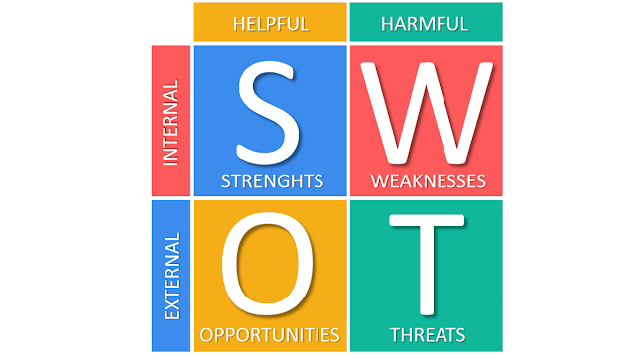
1.2 SWOT Analysis of NEMT project
Strength ● A precise mission, vision, and goal ● A workable Team Structure and Software Development Methodology ● User-friendly and Innovative and Technology ● Top Management Support establishment. Opportunity ● A High-quality Healthcare plan in Colorado ● Market Gap and Market Orientation
Weakness
● Adverse deadlines, exaggerated expectations
● Team members leaving
Threats
● Economic inflation
● Stakeholder issues
Notes:
1.2 SWOT Analysis of NEMT project
As we know SWOT analysis help for strategic planning helps to identify strength, weakness, opportunities, and threats to achieve the desired goal
Strength
Having a clear goal, mission, and vision is one of the top inner strengths of the NEMT project Company.
As it is stated in the company web, the company works towards individualized medical care by providing transportation, home care, and patient remote monitoring system wherever they are and whenever they request.
A workable software development methodology and team structure is another strength the company has established. The NEMT project follows Agile software methodology and team structure principle. According to Burak (2023) , Agile methodology is a practical methodology than the traditional methodology for its iterative approach grants adaptable changes , team collaboration, deployment of products in reasonable schedule, and customer satisfaction. The team structure in agile is also equipped with technical and soft skill expertise that include Project Manager, who plans and tracks the project ;Business Analyst(BA), who reconstruct business needs in to specification document; Software developers , who code the program; Testers who do the quality assurance, and UI designers , who create the visual interfaces. Innovative and user-friendly technology is another strength the NEMT team acquire.
Creating harmony and easiness between the user and the developed technology is one of the major work assignments to the project team. Eastham(2022) mentioned any system product should be created based on client-technology behavior and business assessment that assures both innovations and sustainability.
Additionally, formation of Top Management Support(TMS) in the NEMT software team can be mentioned as a greater strength. Alameri (2022) stated TMS is important in managing and tracking the progress of the project and motivate stuff members by aligning the human and financial resources to achieve the project.
Weakness
Adverse deadlines and unachieved assumption, as well as team member leaving are main limits may happen in software development journey. According to Dennis (2022) budget cuts, Inaccurate assumptions, missing a critical software or hardware components and some other internal and external factors may cause adverse deadlines that lead to unachieved project expectations.
Team members periodically may leave in the middle of critical times due to excessive stress and burnouts and cause substantial risks to the project since it is hard to quickly replace the expertise skills (Harrine, 2022).
Opportunities
WalletHub(2022) mentioned Colorado is among the top states with high quality of healthcare plan based on cost, accessibility and out come
On top of that medical transportation is covered by Medicaid or Medicare for low- income and disabled part of the community (CCHA, n.d.).
Such kind of government support and healthcare plans is advantageous to health-related business-like Non-Emergency Medical Transportation services. The distant locations in Colorado also create a greater market gap that affirm there is an immerse opportunities to run transportation business like the Non-Emergency Medical Transportation business.
Threats
Threats like economic inflation and stakeholder issues may negatively impact the development of the Non-Emergency Medical Transportation(NEMT) software project.
AS Alex, 2022 states, the healthcare technology company as many other technology companies has faced higher wage demands from employees and lower prices demands from stakeholders because of inflation that leads to profit pressures , employees’ layoff , and other consequences on proposed software projects.
Stakeholder issues may have negative impacts on software projects , thus frequent communication, set up clear objectives, knowing what to expect helps to minimize issues with stakeholders.

Slide 6
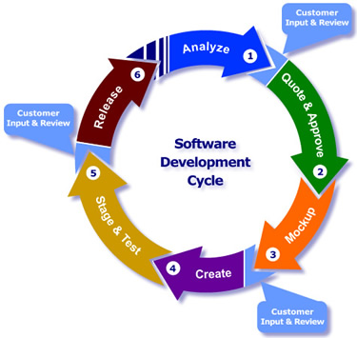
2. Project Work Plan
Using SDLC practices, and the spreadsheet.com for team collaboration, visualization, and scheduling.
The NEMT project has a one year span.
Planning ( 30 days duration) : Assessment, Requirement specification, Stakeholder gathering.
Requirement Analysis ( 60 days duration): Requirement specification, scheduling, and goal analysis.
Design ( 70 days duration) :Brainstorming for solving pre-defined problems.
Proof of concept to verify the software proposal,
Prototype : simulate the system product and get feedbacks.
Hand off : transfer the design to development phase
Notes:
. Project Work Plan
Choosing the right methodology and formulating standardized strategies lead to efficient work plan, resource, and time management in software development projects.
The NEMT project is implementing the Software Development Life Cycle (SDLC) standards in planning , designing, programming, validating , implementing , and maintaining its proposed software project.
By integrating the SDLC practices, the NEMT project team creates its work plans using the spreadsheet.com which has advanced tools for team collaboration, visualization, scheduling, and more
the project has a one-year span with six development phases.
The first is planning( one month duration) that comprises assessment, specification, stakeholder gathering.
Requirement Analysis is the second phase ( 24 days duration) involves requirement specification, scheduling, and goal analysis.
Design is the next phase includes brainstorming for solving pre-defined problems, proof of concept to verify the software proposal, prototype to simulate the system product and get feedbacks, and hand off to transfer the design to development phase
Next the development phase ( 90 days duration) follows and involves creation, coding, testing , and implementation.
Quality assurance is the next work plan , and it is to ensure the quality and standard by reviewing requirements ,creating test cases, and testing for flaws.
Deployment will finally take place by creating showcases and organizing launching events to introduce the final product to users.

Slide 7
Continuing....
Development ( 90 days duration) : Creation, coding, testing , and implementation.
Quality assurance (60 days duration) :Creating test cases, and testing for flaws.
Deployment (60 days): Creating showcases and organizing launching events to introduce the final product to users(Interaction Design Foundation, 2023).

Slide 8
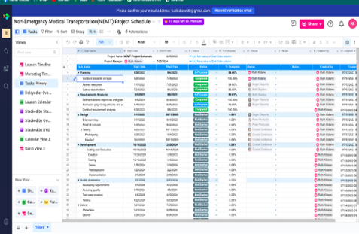
Figure 1
The NEMT project, Stages, Status, Tasks, Schedule

Slide 9
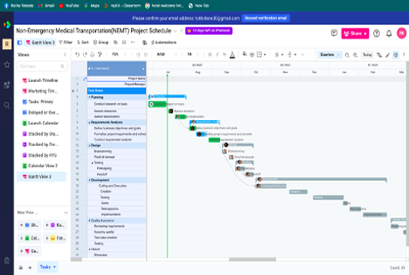
Gantt View of NEMT project
Figure 2

Slide 10
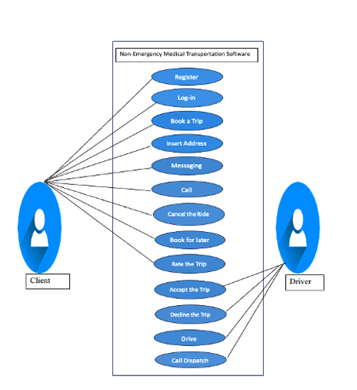
2. 2.1 User Case Data Structure
Figure 3
The NEMT Project User -Data Structure
The NEMT provides different functionality to the User.
Using the NEMT app, user able to register, login, insert pick-up and destiny location, book a trip, call or message customer services , leave a comment, or rate the trip.
The driver able to see the requested trip, the pickup or destiny locations ,accept or decline the trip, and track the traffic using the build-in geo-location system in the app.
Notes:
User Case Data Structure
The NEMT provides different functionality to the User. As it is shown in Figure 3, using the NEMT app, user able to register, login, insert pick-up and destiny location, book a trip, call or message customer services or dispatch. Besides, user can a to leave a comment, rate the trip. On the other hand, the driver able to see the requested trip, the pickup or destiny locations ,accept or decline the trip, and track the traffic using the build-in geo-location system in the app.

Slide 11

3. 3. Measuring and Reporting Team performance and Project progress
In the Agile project team measuring as well as reporting project progress and team performance are the most significant sections.
Key Performance Indicator (KPI) measure scope, cost, quality, schedule, risk , and performance during the software development.
KPIs metrics : 1. Timeliness metrics
2. Quality metrics
3. Budget metrics
4. Effectiveness metrics (Amitava Deb(2023).
Notes:
For the Agile project team measuring as well as reporting project progress and team performance are the most significant sections.
Amitava Deb(2023) stated in highly technical environment implementing standardized key indicators like the Key Performance Indicator (KPI) to measure the project progress and team performance gives efficiency to the measure in terms of scope, cost, quality, schedule, risk , and performance during the software development.
Trammell(2023) noted there are various KPIs metrics which are mainly categorized under Timeliness, Quality, Budget, and Effectiveness metrics. Timeliness metrics deals with completion percentage for tasks, time spent in a task, active days in working tasks ; Quality metrics measures user satisfaction, customer complaints, flaws during and the project development , Budget metrics covers budget variances , and budget iterations ; and Effectiveness metrics measures effort and resource to complete a project such as office space, salaries, and benefits. Table 2 shows the KPIs for the NEMT project according to timeliness, quality and effectiveness metrics.

Slide 12
Table 1
KPIs Metrics for NEMT Project
KPI | Description | Data needed | Reporting tool
Cycle Time | Measures time spent to complete a task and measure the team's performance objectively. | Start date, calendar end date, duration, active hours | Donut charts
Cumulative flow | Visualize the status of the assigned tasks or tickets using stage names “not started”, "in progress, or “completed. | Calendar days, Duration, the number of tasks, percentage completed | Pie chart
Percentage of tasks completed by owner | Measures percentages of the project completed in timely manner by the owner. | Number of tasks, status of the task, owner name, calendar days, duration, active days | Bar Chart
Product Backlog | Refinement of backlog to prioritize tasks based on team decisions and customer requirements | Assessments, specifications, Timelines, Resources, | Line Chart
Overdue tasks | Indicates tasks that pass due dates. | Calendar Day, Tasks name. | Dashboard

Slide 13
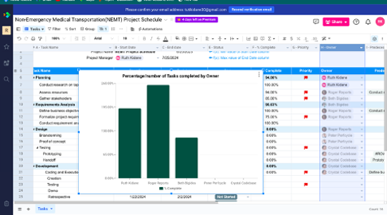
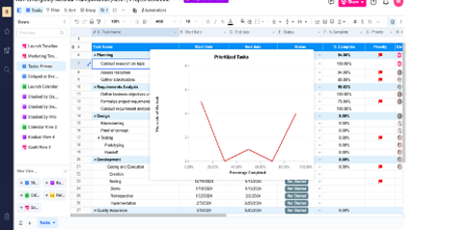

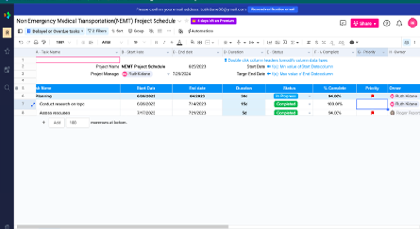
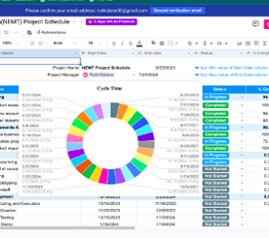
The spreadsheet.com has charts, sheet views, Gantt views , calendar views , Kanban views to report team performance and project progress.
Open AI and spreadsheet AI makes using the platform easier by auto-generate descriptions, formulas, and calculations in creating visual reports(spreadsheet.com, 2023).

Slide 14
3.1 Frequency and Processes of Reporting Progress and Performance
In Agile projects, reports are done in standardized meetings know as Scrum meetings that participate;
Project Manager who is responsible for designing the product
Scrum Master who is responsible for progress tracking and team performance
Developing team who works directly in creating the system product (Radigan, n.d.).
Agile project meetings are arranged by assigning a maximum unit of time known as Sprint to a task.
Based on the Sprint agile meetings are encompassing four types of meetings.
Daily Scrum is carried on every morning, once in a day and takes up to 15 minutes and updates about project to the team.
Sprint Planning is held at the beginning of Sprint, and it is to make the team ready for success the sprint.
Sprit Review a 90-minute duration is done at the end of the sprint and reviews the performance of the team and the progress of the tasks in sprint.
Sprint Retrospective a 90-minute duration and carried on at the end of the sprint and aims for gathering feedback and analyzing performance and progress(Osborne, 2022).
Notes:
Reporting of progress and performance is important for team collaboration, tracking the progress, and improving performance. In Agile projects, reports are done in standardized meetings know as Scrum meetings. Team members , and managers participate in scrum meeting from the Project Manager who is responsible for designing the product , Scrum Master who is responsible for progress tracking and team performance to Developing team who works directly in creating the system product (Radigan, n.d.).
Osborne(2022) noted how frequent Agile meetings are held. Agile project meetings are arranged by assigning a maximum unit of time known as Sprint to a task.
Based on the Sprint agile meetings are encompassing four types of meetings. These are: Daily Scrum, Sprint Planning , Sprint Retrospective, and Sprint Review.
Daily Scrum is carried on every morning, once in a day and takes up to 15 minutes and updates about project to the team.
Sprint Planning is held at the beginning of Sprint, and it is to make the team ready for success the sprint.
Sprit Review a 90-minute duration is done at the end of the sprint and reviews the performance of the team and the progress of the tasks in sprint.
Sprint Retrospective a 90-minute duration and carried on at the end of the sprint and but aims for gathering feedback and analyzing performance and progress.
Radigan( n.d. ) also stated that in agile projects, communication with stakeholders is also arranged at the end of sprint implementing, dashboards, visual reporting charts or other tools for easy understanding. In addition, meetings are held at the beginning of the project to conduct assessments collect requirements and evaluates business intelligence of project. Launching events also be organized in the deployment stage of the project to showcase the final product to stakeholders, vendors, or end users.

Slide 15
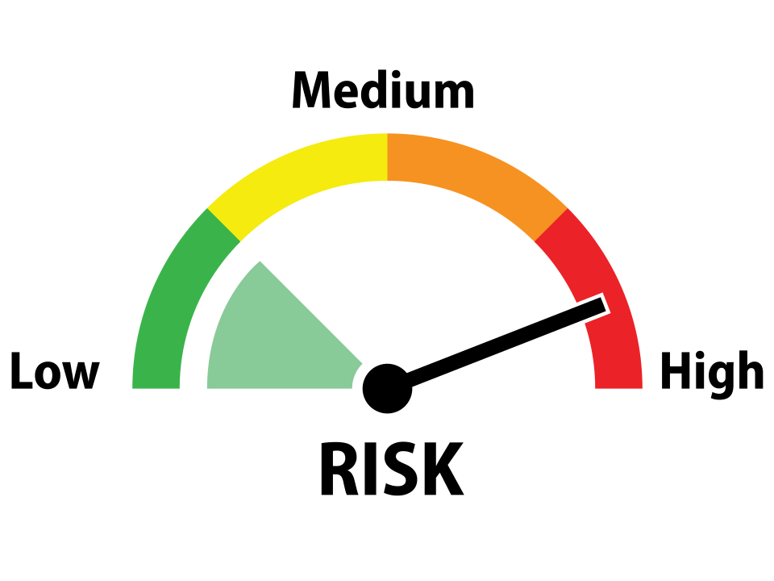
4. Risk Reduction Strategy
Risks in software are the chance of encountering harm to the company, stakeholder, or end user due to intentional or unintentional activities.
The damage could be finical loss, legal consequences , loss of reputation, loss of market share, project delays, and more.
Risks can happen because of poor assessment and planning, lack of resources, wrong estimation, security risks, and terminations(Blue fruit Software , 2023).
Software risk management:
Risk assessment comprises risk identification , analysis , and prioritization whereas
Risk controls include risk monitoring, risk management planning, and risk resolution and mitigation(DevTeam.Space, 2023).
Notes:
Risk Reduction Strategy
According to Blue fruit Software (2023), commonly software projects are dynamic, uncertain and complex involve different risks that affect their scope, cost, schedule , and quality.
Risks in software are the chance of encountaring harm to the company, stakeholder, or end user due to intentional or unintentional activities. The damage could be finical loss, legal consequences , loss of reputation, loss of market share, project delays, and more.
Risks can happen because of poor assessment and planning, lack of resources, wrong estimation, security risks, and terminations, etc.
An efficient software project management have both the knowledge on risk possibilities and practical actions to identify and , analyize risks and proactively execute risk controls. Shah (2021) noted integrating risk reduction strategies helps to save time, resources, and money that could be spent for unpredicted risk emergency, builds a sound reputation, support to have a smooth and speedy project accomplishment.
DevTeam.Space(2023) explained how software risk management works best.
Mostly a software risk management is the assimilation of risk assessment and risk controls.

Slide 16
4. 1 NEMT Project Risk Management Risk Matrix
To achieve both risk assessment and risk controls, specific tools and are undertaken. For example, in risk assessment we use qualitative or quantitative techniques to estimate the probability and impact of the risks. We also use risk matrices and risk registry to systematically classify and visualize the risk details. ​
Table 2​
NEMT Project Risk Management Risk Matrix​
Probability | Impact
 | Insignificant | Minor | Neutral | Major | Catastrophic
>90 Probability Certain | Moderate | High | Extreme | Extreme | Extreme
50%-90% Probability Likely | Moderate | High | High | Extreme | Extreme
10%-50% Probability Moderate | Low | Moderate | High | Extreme | Extreme
3%-10% Probability Unlikely | Low | Low | Moderate | High | Extreme
<3% Probability Rare | Low | Low | Moderate | High | High
Notes:
NEMT Project Risk Management Risk Matrix
Wikipedia (2023) defined Risk matrix as a matrix in risk assessment that creates risk visibility by defining the level of the risk using the probability and impact rates of the risk
As it shown in Table 2, low or moderate risks have chance of encountering 3% to 90% , but have insignificant or minor harm. Nevertheless, high or extreme risks have a huge harm but can have 3% to 90% of chance of occurrence. According monday.com(2022), insignificant risk harms can be mitigated in routine process, minor harms can cause 10% schedule delays and 10% additional budget , moderate harms leads to 30% schedule delays and 30% additional costs, major harms are may cause 50 % schedule delay and 50% additional cost, and catastrophic harms can cause project termination.

Slide 17
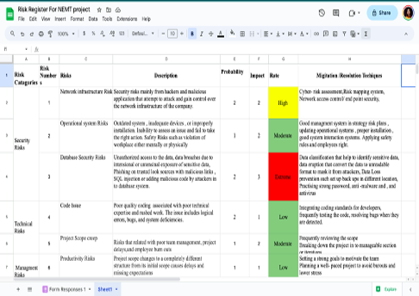
Figure 4
NEMT project Risk Registry
4.2 NEMT Project Risk Management Risk Registry
A risk register is a technique used to organize risk events, and classify risks based on their severity and assign them for management to team members.
In creating risk registry, quantitative or qualitative r methods are implemented. We use qualitative assessment in creating the NEMT risk registry to measure the probability and impact with point scale of 1-5 that represents very high, high , medium, low , and very low and we rate the severity of the risk by multiplying the probability and impact number scale (Everitt, 2022).
Notes:
4. 2 NEMT Project Risk Management Risk Registry
Everitt(2022) described risk registry. A risk register is a technique used to organize risk events, and classify risks based on their severity and assign them for management to team members. In creating risk registry, quantitative or qualitative r methods are implemented.
We use qualitative assessment in creating the NEMT risk registry to measure the probability and impact with point scale of 1-5 that represents very high, high , medium, low , and very low and we rate the severity of the risk by multiplying the probability and impact number scale.

Slide 18
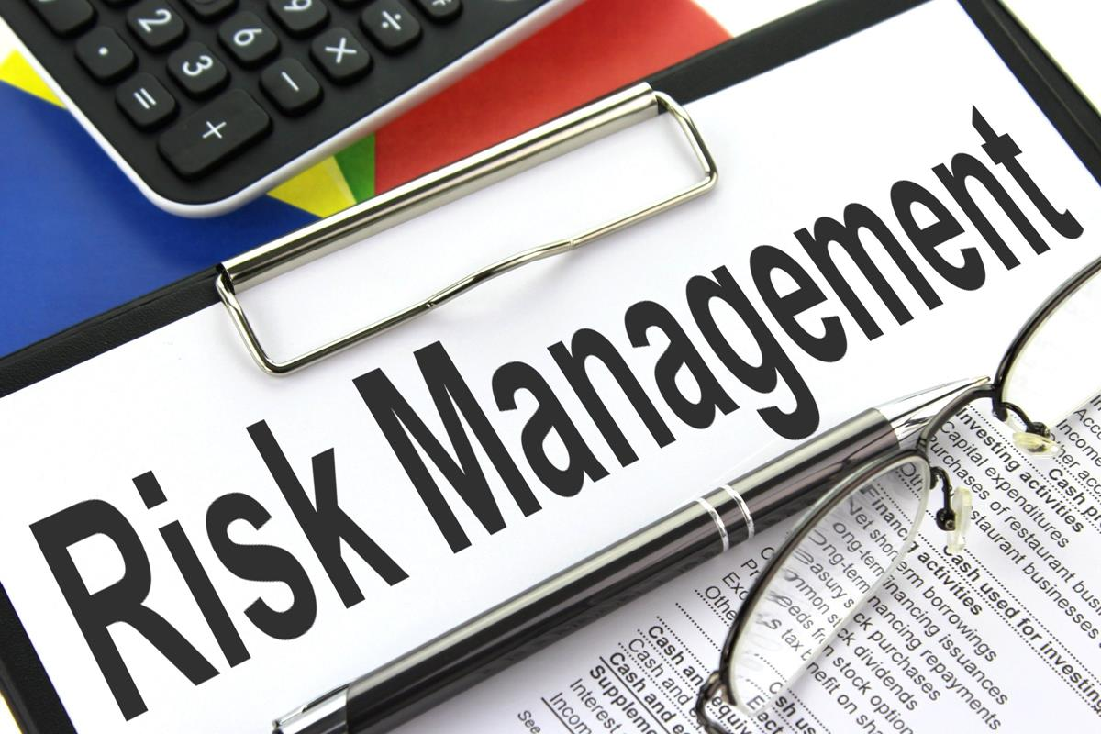
4. 3 The NEMT Project Risks Mitigation Techniques and Legal Measures
Focus on risk assessment and controls of the security risks, technical risks, and management risks.
4.3.1 Security Risk
Network Security risks: malicious application from and hackers and that try to attack and capture control over the network of the company. Mitigation protects network components such as routers, firewalls, switches, servers, intrusion detection systems(IDS) and domain name systems(DNS) Cyber- risk assessment , mapping system, network access control, risk security solutions
Operational risks: inadequate devices, outdated system or improperly installation, and inability to control an issue. High level management plans, proper installation , updated operational systems , good interaction systems, safety rules help in resolving the operational issues (VMware ,2023).
Notes:
4. 3 The NEMT Project Risks Mitigation Techniques and Legal Measures
The NEMT Project Risks Management focus on risk assessment and controls of the security risks, technical risks, and management risks.
4.1 Security Risk
Secuity risks are mainly network infrastructure risks, operational system risks, and database risks. Network Security risks are malicious application from and hackers and that try to attack and capture control over the network of the company. Network risk mitigation protects network components such as routers, firewalls, switches,intrusion detection systems(IDS) and domain name systems(DNS), Cyber- risk assessment , mapping system, network access control, risk security solutions like antivirus, firewall, patch managements help the security team to stay ahead of the network security attacks(VMware ,2023).
According Segal (2023) operational risks are associated with inadequate devices, outdated system or improperly installation,and inability to control an issue. Management system with high risk management plans,proper installation , updated operational systems , good

Slide 19
Continuing......
Database risks : data breaches and unauthorized access to the data due to intentional or unintentional vulnerability of sensitive data, SQL injection by attackers into database system , and phishing on malicious links. Data classification, data eruption ,data loss prevention strong password, antimalware and , and antivirus are the valuable mitigation database risks (Imperia , 2023).​
4.3.2 Technical Risks
Code issue : Poor quality coding , bugs, logical errors, and system deficiencies are the issues in software development phase. Integrating quality coding standards for developers, and quality assurances mitigations in coding problems (Indeed Editorial Team, 2023).
Project scope : Project may change to a different structure from its initial scope thus, regularly examining the scope, iterations or splitting the project into manageable portion help for creeping problems(Indeed Editorial Team, 2023).
Notes:
nteraction systems, safety rules help in resolving the operational issues.
Database risks associated with data breaches and unauthorized access to the data due to
intentional or unintentional vulnerabity of sensitive data, SQL injection by attackers into database system , and phishing on malicious links. Data classification, data eruption ,data loss prevention strong password, antimalware and , and antivirus are the valuable mitigation database risks (Imperia , 2023).
4.2 Technical Risks
Code issue and project scope creep are one of the techniqul risks in software projects.
Poor quality coding , bugs, logical errors and system deficiencies are the issues in software development phase. Integrating quality coding standards for developers, and quality assurances mitigations in coding problems (Indeed Editorial Team, 2023).
Rarely, project scope may changes to a different structure from its initial scope thus, regularly examining the scope, iterations or splitting the project into manageable portion help for creeping problems(Indeed Editorial Team, 2023).

Slide 20

4.4 Legal Consideration in NEMT Project
Software auditing and IP policy definition to the project are important legal measures in software risk management.
A software audits is an internal or external inspection of a software project examines its quality, adherence plans and legal regulations.
IP policy comprehend policy and procedures constructed by the software company related to usages, communication, and creating intellectual properties(IP) like trademarks, patents, trade secrets, and copyrights. IP policy must be clearly defined based on legal consultation , business goals, and engineering process that enable to be a safeguard to the system product originality and business growth (Hassin, 2010).

Slide 21
5. IT Support program in the Healthcare Technology Company
IT support or Service Desk improves user experiences, using resources and time in resolving user issues. IT support is a contact point for solving user problem and bridge connects the company and user. The fundamental IT support is the performance of the five IT support levels. These are level 0, level 1, level 2, level 3, and level 4 IT support(Kidd, 2019)
IT Support -Level 0 : A technology driven services or self-services for solving minor user issues.
log-in issues, change password, and easy usages of software and hardware components.
Reducing the wasting time of qualified expertise( Nazari, 2022).
IT Support-Level 1 : Technical support begins in level 1.
Person-to person first line contact .
Solves IT routine cases and issues that level 0 cannot resolve.
The responsibilities includes user account management, end user technical support,
proactive incident (Nazari, 2022).
Notes:
IT Support program in the Healthcare Technology Company
Technological evolution has revolutionize user experiences by carry out seamless and consistent services over the companies’ platforms. Kidd(2019) converse about IT support in improving user experiences, IT stuff efficiency to use resources and time in resolving user issues.
IT support also known as Technical support or Service Desk a contact point for solving user problem and bridge connects the company and user. Companies with authentic, friendly, fast and supportive service desk have recorded as a higher reputation ,customer satisfaction, and business scalablitty.
According to Buchanan(2023) Service desk or IT support is important for being IT requests, incident management, proactive problem solving, and trustable reporting center . The fundamental of Service desk or IT support is the performance of the five IT support levels.These are level 0, level 1, level 2, level 3, and level 4 IT support.
5.1 IT Support -Level 0
Level 0 is a technology dirven services or self services for solving minior user issues by following visual or written instructions.level-0 IT support provides a self-service portal to register user issues, service catalog to direct to service information, a knowledge base articles on how-to information, help-sections ,and user guides.
Minior issues like log-in issues , password resets ,and easy usages of software and hardware components, are carried on in the zero level.
This level has a valuable role in reducing the wasting time of qualified expertise on answering to every user requests over the phone ( Nazari, 2022).
5.2 IT Support-Level 1
Hertvik(n.d.) noted IT support level-1 is where the technical support begins in a directly contact with the support team.
Level 1 is known by person-to person first line contact to solve issues that self-service cannot solve
. Level-1solves IT routine cases and issues that level 0 cannot resolve.
The responsibilities of level-1 stuff includes user account management, end user technical support, proactive incident management, issue resolution and documentation, troubleshooting, and system installation and updates.
Level-1 support team have both technical and non-technical skills.Soft skill like communication skills and customer service are typical to level-1 IT support stuff for they are responsible effectively communicate and clearly understands user issues.
Level 1 team analyze the issue and provide an IT solution and if the issues require extra technical assistance , the team will escalate the issue to level-2 IT support stuff.

Slide 22
IT Support-Level 2 : Main actor in the IT five model support.
-Solves problems that could not be solved in previous level.
-Develop technical based articles, documenting mitigation techniques ,
and contacting or visiting the customer if it required.
-The team is with high level IT skills
IT Support-Level 3 :The top technical level support
-Greater quality resources and permissions to design, engineer, and maintain
-Certify tickets are properly scaled, develop improvement programs
troubleshoot issues in detail , develop knowledge-based guidelines,
-Communicate stakeholders and document resolution procedures (Nazari, 2022).
.

Slide 23
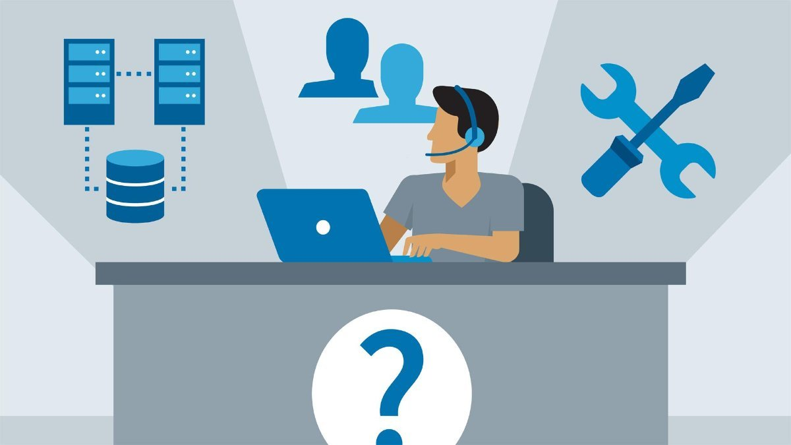
........Continuing
IT Support- Level –4 : The final and external IT support level for the complex issues
-Aims to resolve complex incidents effectively by utilizing IT outsourcing.
- Outsourcing is a technique of replacing inner IT resource of a company with external IT resources for issue mitigation and technical consultation (Aranda ,2022).
Notes:
5.3 IT Support-Level 2
Danby(2023) mentioned the IT support level-2 is the main actor in the IT five model support.
It involves complex IT incidents that could not be solved in previous level, develop technical based articles, documenting mitigation techniques , and contacting or visiting the customer if it requiredt.
The level-2 IT support team is equipped with high level IT skills who to troubleshoot deeper and solve problems with informed anticipations .
2.3 Level 3- IT Support
Level 3 is the top technical level support in the five model IT support.
Mottesi(2023) discussed level 3 IT support has greater quality resources and permissions to design, engineer, and maintain multilevel IT issues.
The level 3 IT stuff analyze user needs and support streams to certify tickets are properly scaled, develop improvement programs , troubleshoot issues in detail , develop knowledge based guidelines, communicate stakeholders for common solutions, and document resolution procedures.
2.4 Level 4- IT Support
Level 4 is the final and external IT support level for the complex issues that previous IT desk levels unable to solve.
It aims to manage and resolve complex incidents effectively using IT outsourcing. Aranda (2022) described IT outsourcing as a technique of replacing inner IT resource of a company with external IT resources for issue migitation and technical consultation.
The level 4 IT desk is responsible in solving issues that level 1,2, and 3 IT support levels could not solve.

Slide 24
Conclusion
In today's dynamic IT world, creating a good quality system solution requires a coordination of human, technical and behavioral skills, and efficiently usage of resources. Understanding this , the NEMT software project team conscientiously construct its project plan , documenting knowledge-based work procedures , preparing its members with all technical and soft skills , and assemble the right methodologies and tools to develop the proposed solution. The NEMT team started its project by conducting business assessment, requirements specification, and analyzing the requirement using a popular strategic plan SWOT analysis. This helps to have a clear understanding on the business goals , user requirements, and determine what to improve and continue to work. By implementing the Software Development Life Cycle(SDLC) the team able to organize its work plans, and sketch timelines and required resources in the spreadsheet.com tool. Additionally, KPI technique is integrated to measure project progress and team performance using carefully studied metrics and communication progress and performance reports has been achieved through Scrum meetings . Furthermore, risk reduction strategies are incorporated to proactively response the inevitable risks during the project using software risk management methods and tools such as qualitative risk assessment, risk matrix , and risk registry. At last, IT support services is coordinated as part of project to ensure there will be a continuous connection between the user and the company to solve any simple to multi-level user issues.

Slide 25
References
Amitava, D. (2023). What are the key performance indicators (KPIs) for software project management? LinkedIn.
https://www.linkedin.com/advice/0/what-key- performance-indicators-kpis#
Burak, A. (2023, May 23). Agile Software Development Team Structure. Relevant.
https://relevant.software/blog/what-agile-software-development-team-structure-looks-like/
Danby , S. (2023, January 5). The Basics of Tier 2 Help Desk. Invgate blogs.
https://blog.invgate.com/tier-2-help-desk
Haidari, R. (2023, May 24). Agile Reporting: How to Streamline Data Collection and Reporting for Your Team. Go Retro.
https://www.goretro.ai/post/agile-reporting
Fingent. (n.d.). Top Technologies Used to Develop Mobile Apps. Fingent.
https://www.fingent.com/blog/top-technologies-used-to-develop-mobile-app
Modivcare. (2023a). How it works. Modivcare. https://www.mymodivcare.com/how-it-works
Interaction Design Foundation. (2023). Brainstorming. Interaction Design Foundation.
https://www.interaction-design.org/literature/topics/brainstorming
Osborne, K. (15AD). Agile Meetings 101, How to conduct them properly. Nifty. https://niftypm.com/blog/agile-meetings-
Vaghela, P. (2023, April 7). A Comprehensive Guide to Healthcare Software Development In 2023. Big Scal.
https://www.bigscal.com/blogs/healthcare-industry/guide-to-healthcare-s

